Slide 1


Slide 2
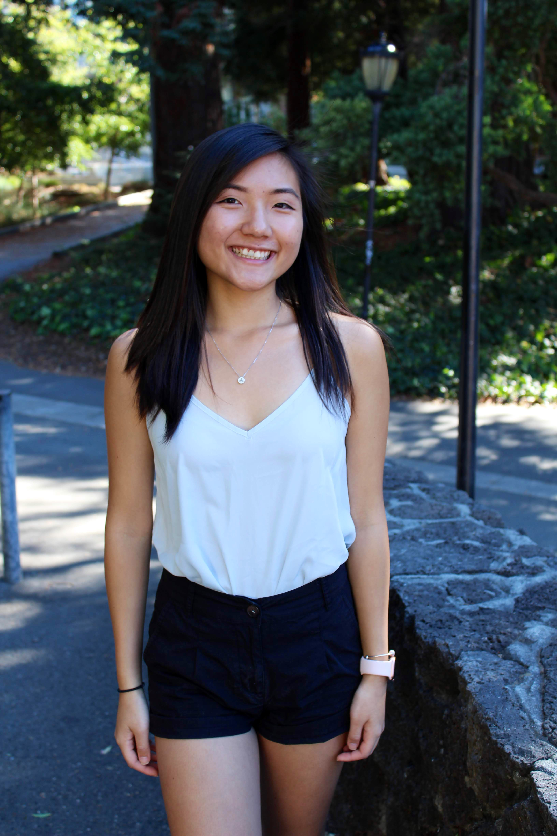
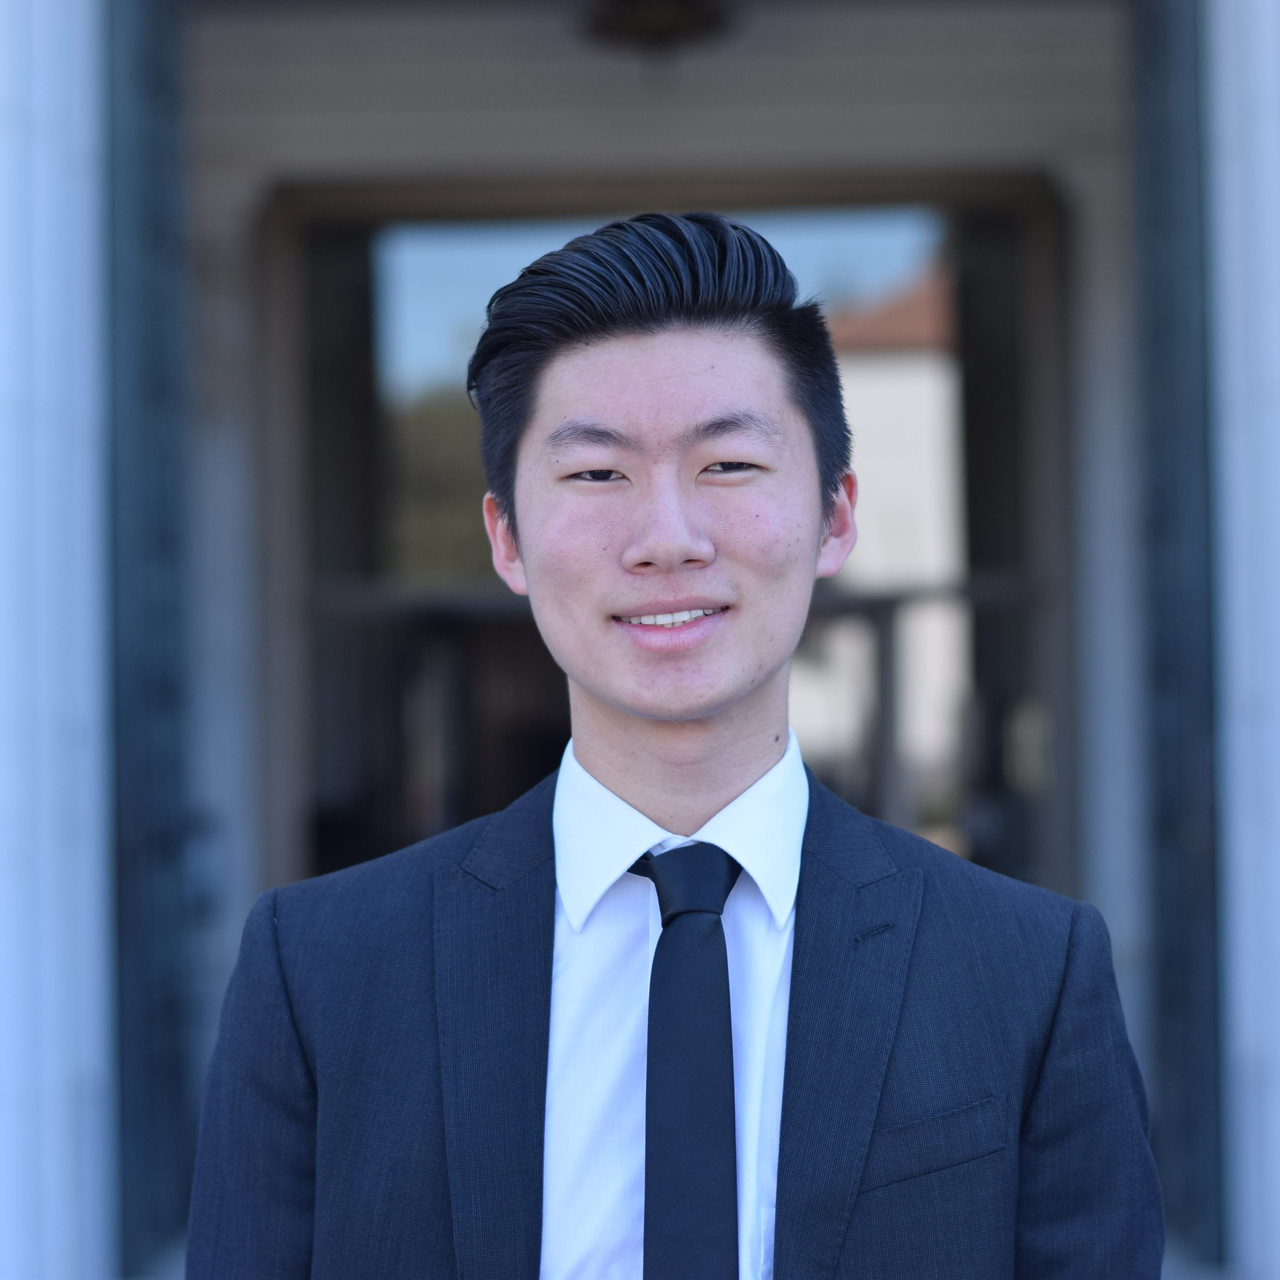
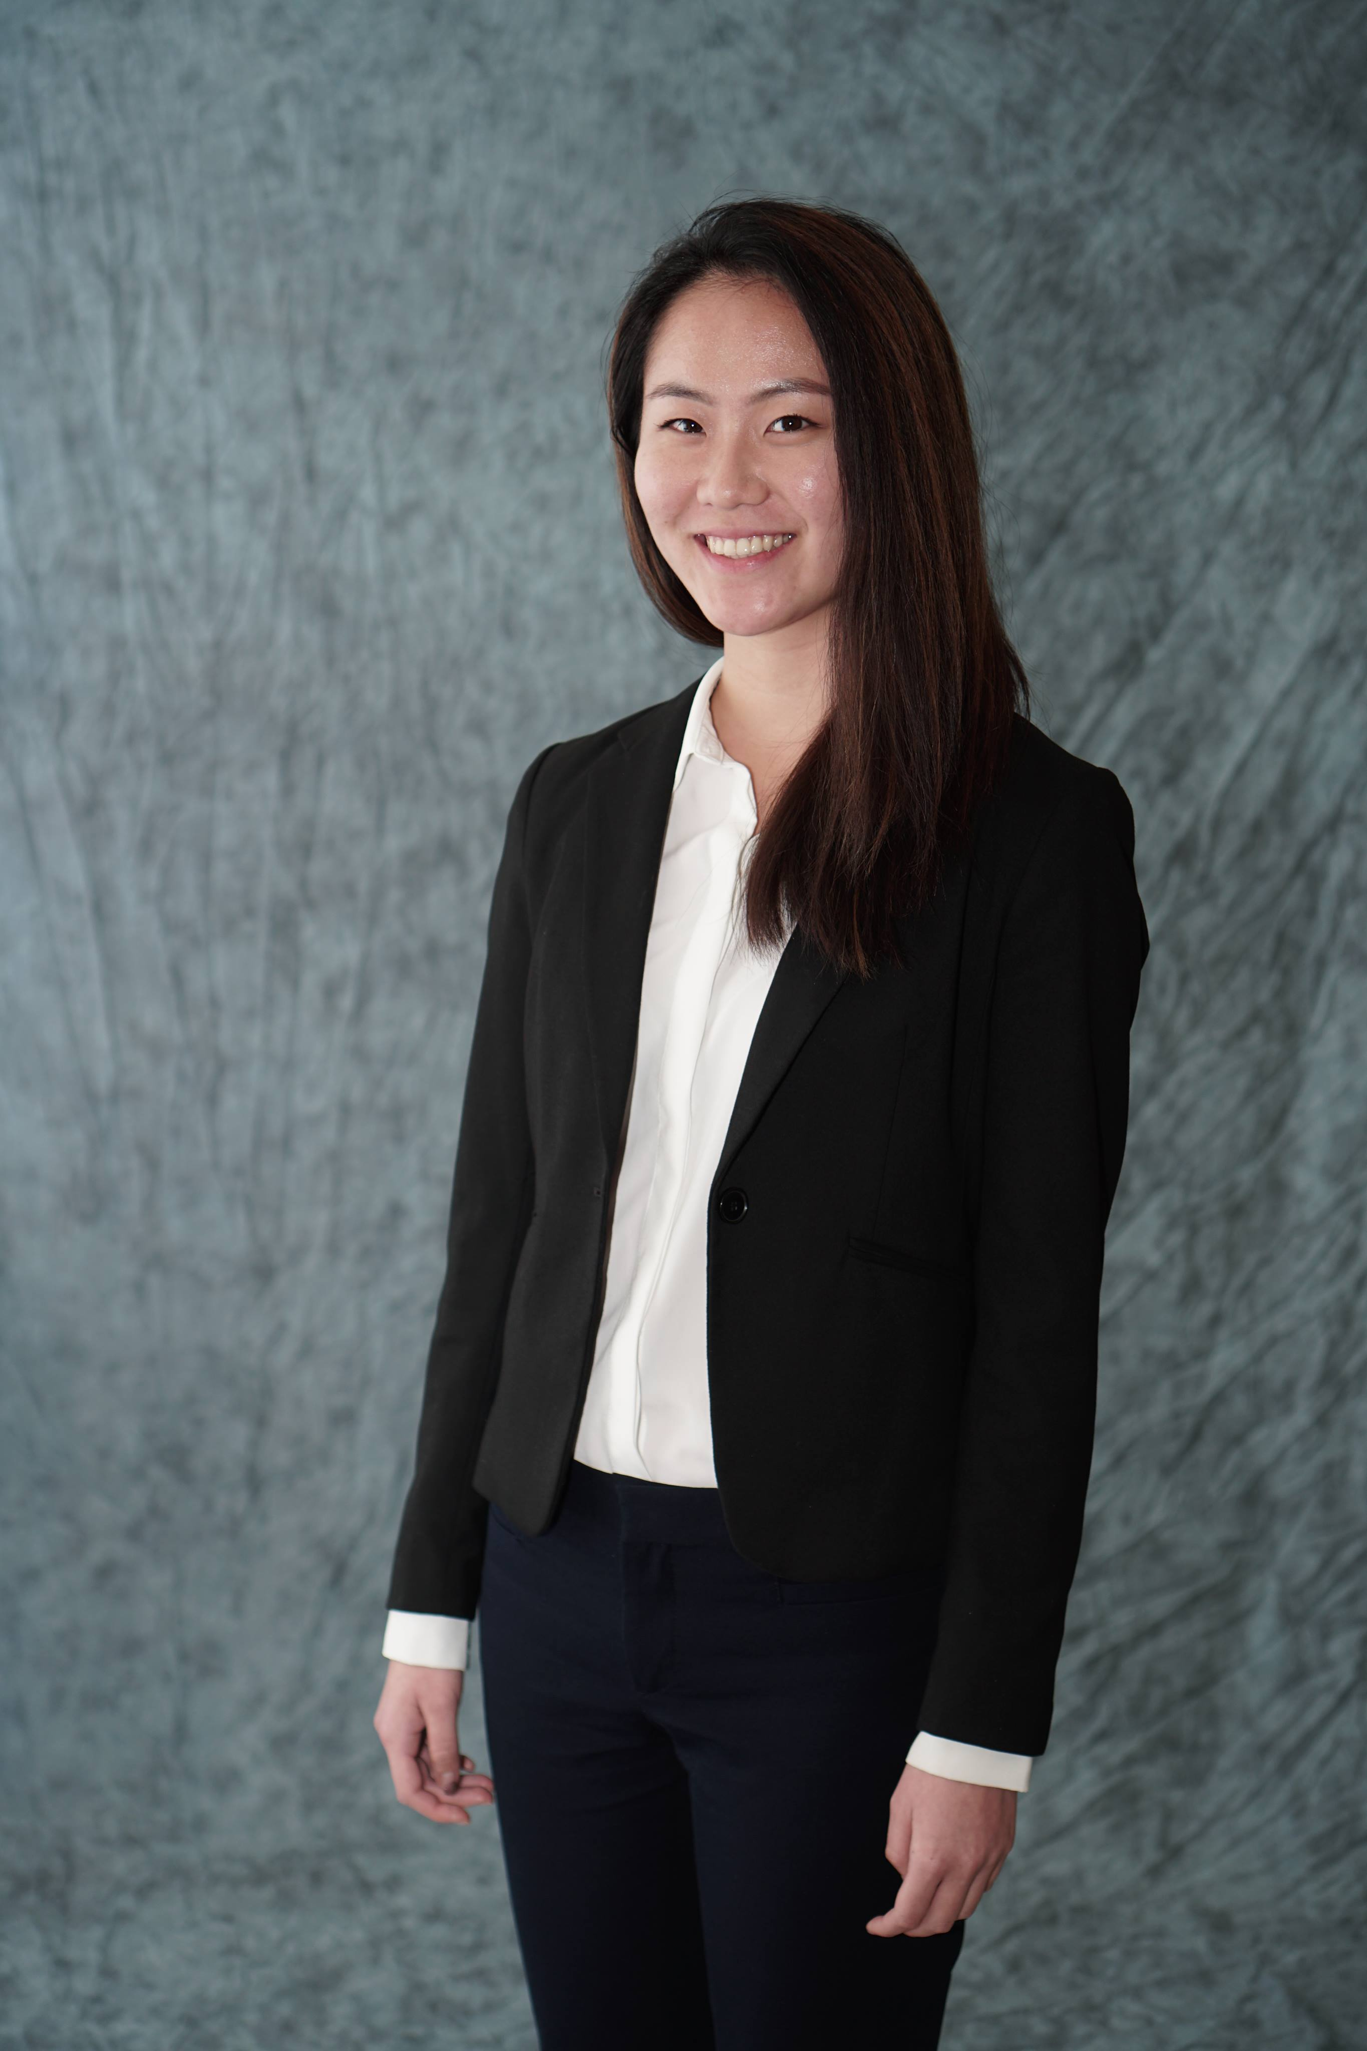
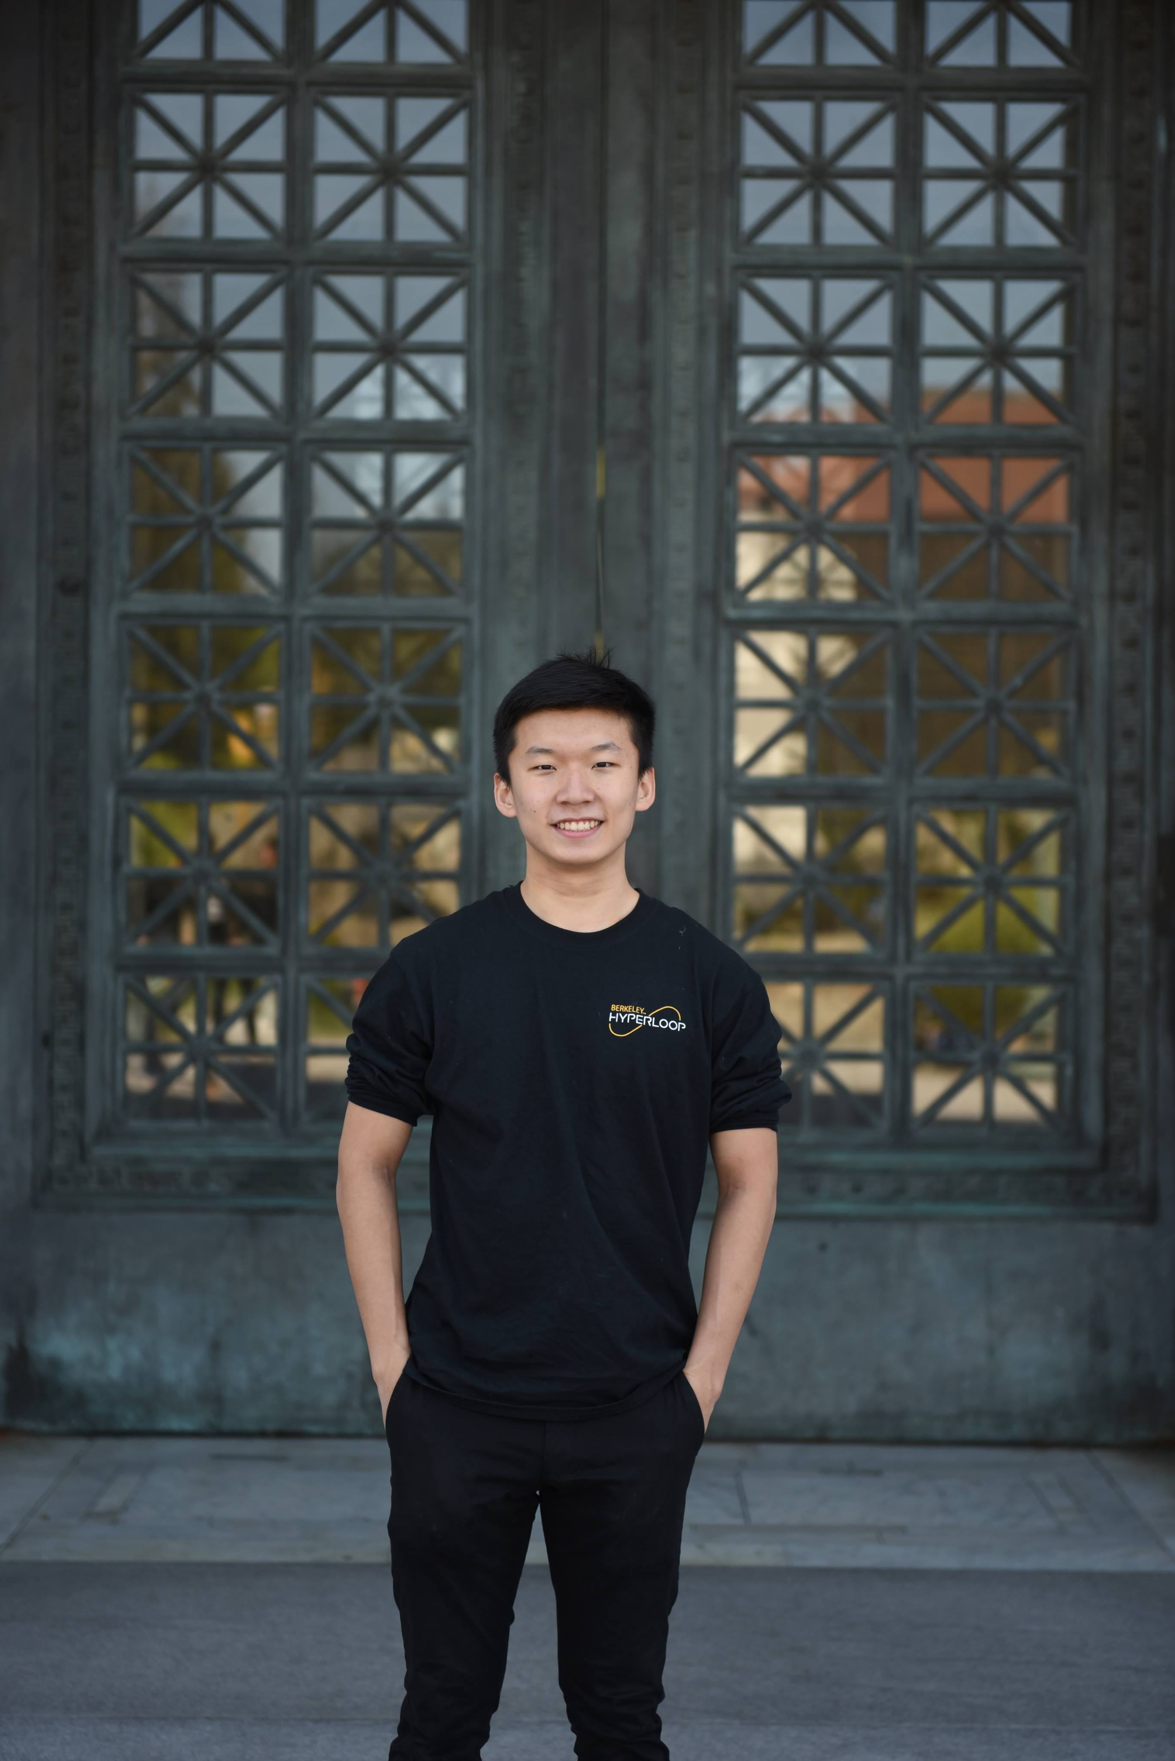
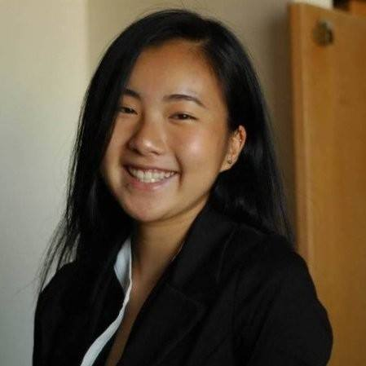
Management Team
Alexis Wei
Freshman
MechE
Creator
Joe Sun
Junior
EECS
Creator
Emily Sun
Freshman
MCB/pre-Haas
Creator
Yifan Ding
Sophomore
IEOR/Data Sci
Creator
Nana Yoshimure
Sophomore
Business
Creator
Overview
Analysis
Product
Appendix

Slide 3
Problem
Analyzing the main issues regarding the lack of services for professional clothing rentals
Variety
Affordability
Waste
There is a lack of variety in sizes and styles for professional attire. | Professional clothing attire is not accessible to most college students due to its high price points. | Purchasing a professional clothing attire can be wasteful if only used in special occasions.
Considering the inconvenience of professional attire amongst college students, there is a need to generate a solution.
Overview
Analysis
Product
Appendix

Slide 4
Solution
Generating a solution to make professional attire more accessible for college students
App
Creating an online rental marketplace for professional attire targeting college students
Increased Variety
Save Money
Students can select their choice of professional attire style with different fits and sizes.
Students can save money by renting professional attire for occasions instead of purchasing.
Earn Money
Environmentally Friendly
Students can earn money by lending out their wardrobe and benefiting from other online features.
This rental platform will be overall environmentally friendly due to the reduction of waste.
College students can increase their accessibility to professional attire through the development of a rental app.
Overview
Analysis
Product
Appendix

Slide 5




Value Proposition
Why we attract our target customers
Convenience
Variety
Fitting into a fast-paced lifestyle by saving time through pick-ups
Giving consumers a large number of professional occasion-wear to choose from
Affordability
Sustainability
Lowering customer costs by providing high-quality clothing for rent
Reimagining a less wasteful and more resourceful fashion industry
By providing convenience, affordability, variety, and sustainability, we differentiate ourselves as a rental model
Overview
Analysis
Product
Appendix

Slide 6
Implementation Timeline
Major tasks moving forward
Negotiate transportation contracts and partnerships
Launch app
Pursue expansion ideas
Prototyping: Build the app and storage unit
Beta test storage units in Berkeley
Business remodeling using feedback
Over the course of 6 quarters, we plan to fully test and launch Suitable
Overview
Analysis
Product
Appendix

Slide 7
Marketing Strategies
Strategies to quickly attract both renters and borrowers to use Suitable
Attracting Renters
Attracting Borrowers
Promotional Incentives
Promotional Incentives
Full Profit for renters for their first month of rentals
Offer a Promotional Discount for buyers’ first rental
App Partnerships with popular apps around campus (e.g. Snackpass)
Offer Free Uber Rides to help users pick up their first rental
Advertising Channels
Reach UC Berkeley students through popular Facebook Groups
Advertising on professional sites to reach target demographic
Pay campus clubs to advertise Suitable to candidates
Our marketing strategies should focus on appealing to our target demographic:
professionally-focused college students
Overview
Analysis
Product
Appendix

Slide 8
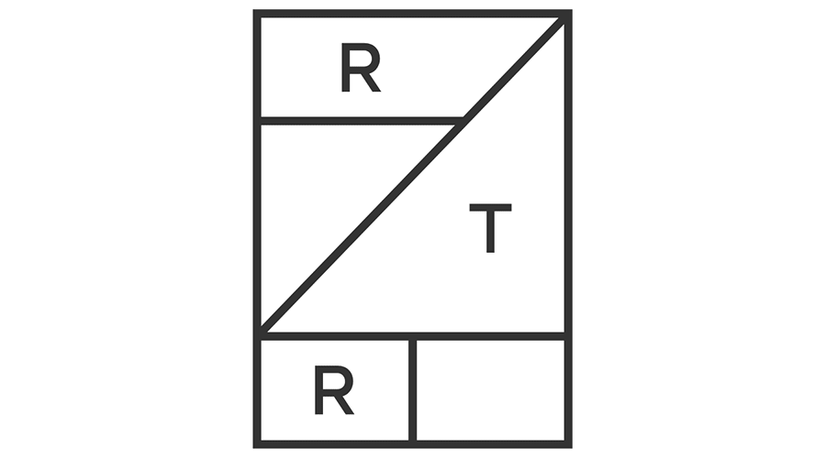

Competitor Analysis
Analysis of the strengths and weaknesses of two of our potential competitors
Rent the Runway
Le Tote
Ecommerce company that specializes in designer dress rentals
Subscription-based rental fashion service for women
Offers one-time rentals, monthly subscriptions, and unlimited rentals
Users choose what clothes they want to rent at the start of each month
Strengths
Weaknesses
Strengths
Weaknesses
High-quality rentals for 10% of retail value
Female-only clothing options
Variety of new clothes every month
No option for one-time rentals
Highly reputable and trusted among users
Poor fit and slow delivery times
Option to buy clothes at the end of rental
Poor quality and lack of professional attire
Suitable can emulate Rent The Runway’s success by gaining the trust of its customers
Suitable’s focus on one-time, professional rentals could address several of Le Tote’s pain points
Overview
Analysis
Product
Appendix

Slide 9





Mobile Application Design
Features and Designs for the BEST User Experience
Suitable Occasions
Machine Learning Measurements
Proprietary analysis algorithm
The best fit for the best impressions
Eliminates real life try-ons
Business
Professional
Business
Casual
Casual
Chic
Suitable Occasions
Seamless Transactions
Safe and secure with company account
One click is all that you need
Overview
Analysis
Product
Appendix

Slide 10
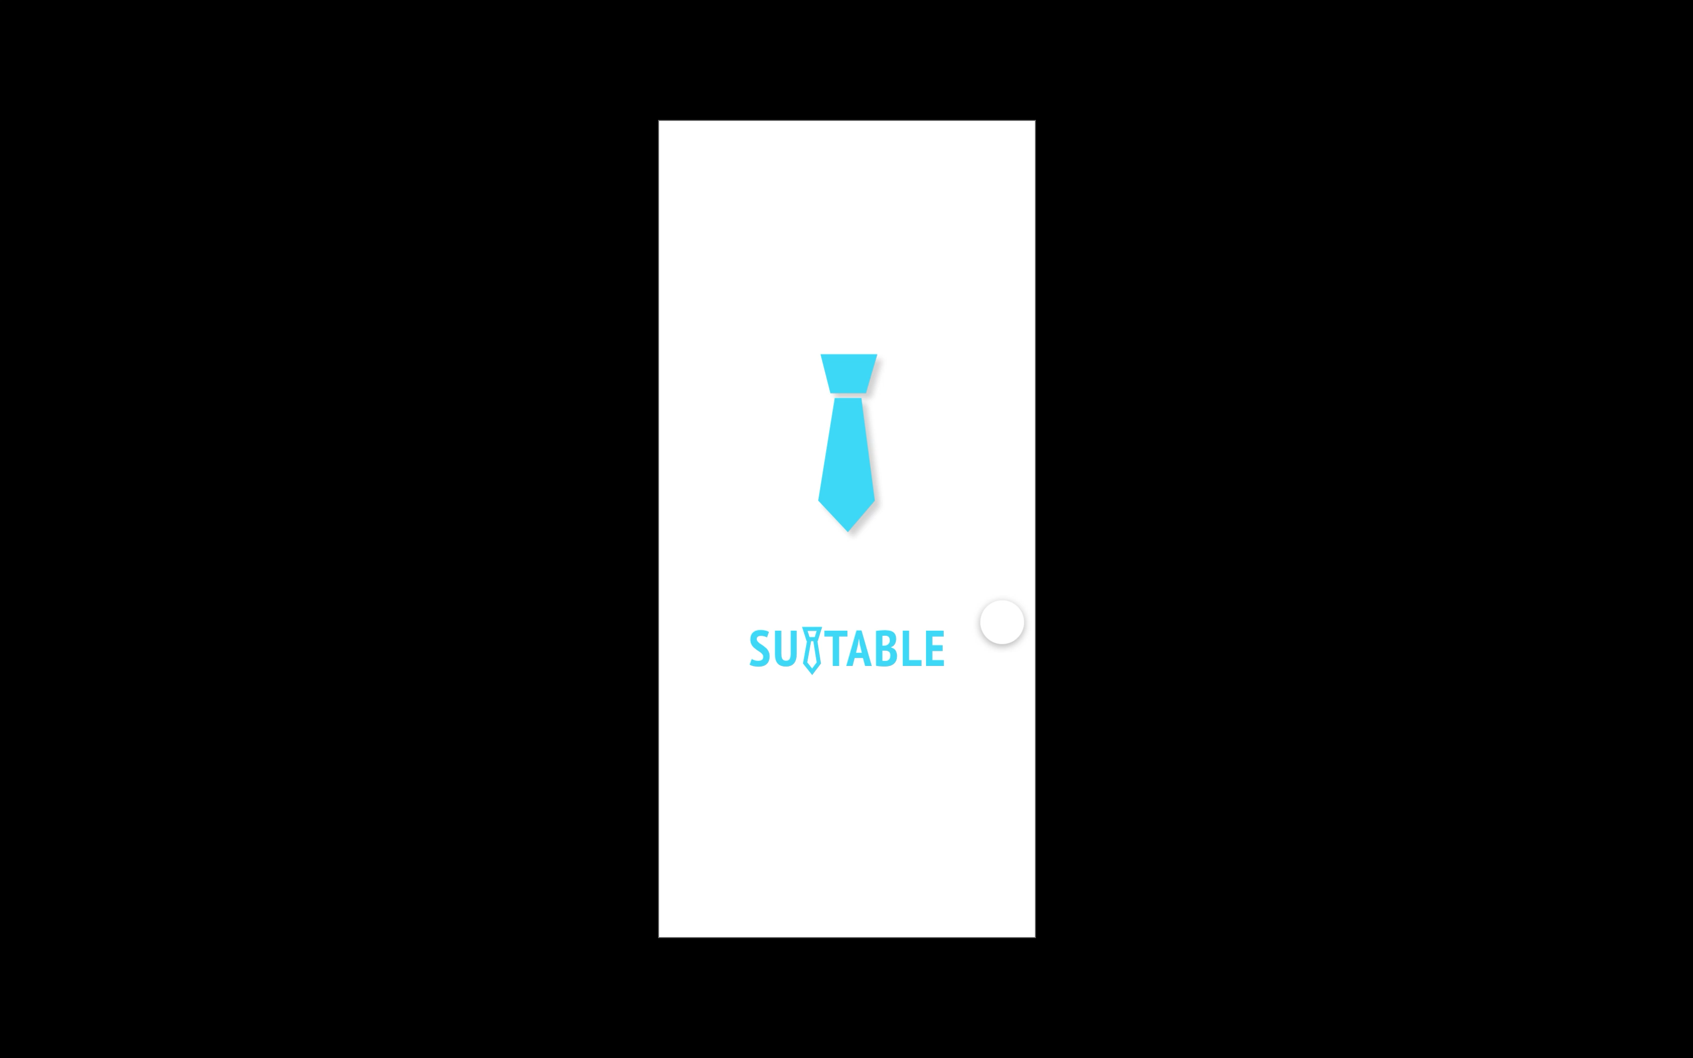
Mobile Application Demo
See what Suitable can do
Overview
Analysis
Product
Appendix

Slide 11

Business Model
Financial viability of the business model
Automated Revenue Stream
US Market
Cost per unit of manufacture: $5,000
TAM:
16,000,000
Duration before recovering initial
investment: 48 days
SAM:
10,000,000
100% profit margin after breaking even
0 maintenance / repair costs
SOM:
2,000,000
Business model analogous to Bird / Lime
*Every single consumer is potentially 10 transactions a year
Overview
Analysis
Product
Appendix

Slide 12



Future Projections
Growth into the future
Geographically
Further expansion into other school campuses
Automated stations facilitating transactions in every major city: SF / NY / Chicago
Projected annual revenue: $20,000,000
Easily transferable model to foreign countries like the UK
Overview
Analysis
Product
Appendix

Slide 13
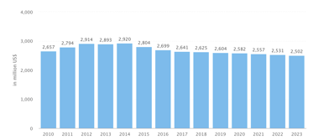
Appendix: Financial Analysis
Kicker goes here
Estimated cost of mass producing one unit: $5000 (ask me how)
Transactions per day per unit: 10
Mean profit per transaction: $3 (for facilitating) / $15 (for providing)
Breakeven point: 5000 / 105 = 48 days
----------------------------------------------------------------------------------------------------------------
Revenue of the suit market
Overview
Analysis
Product
Appendix

